Slide 1
youtube Y O U T U B E TAG분석
목요일이다아

Slide 2
IN. DE. ..X
CONTENTS
DESIGN
TRENDS
PROMOTION

Slide 3
DATA 데이터 정보
PERSONAL
PROJECT
DATA INFORMATION
• 데이터 수집 : https://www.kaggle.com/datasnaek/youtube
• 기간 : 2017.09.13 ~ 2017.09.24
• 변수 : video_id title channel_title category_id tags views likes dislikes comment_total thumbnail_link date
• 기간 : 2017.09.13 ~ 2017.09.24
• 목적 : 키워드 찾아 워드클라우드 그리기!
졸려
- YEARANG KO

Slide 4
DATA 전처리
PERSONAL
PROJECT
PRE PROCESS
•
• 기간 : 2017.09.13 ~ 2017.09.24
• 변수 : video_id title channel_title category_id tags views likes dislikes comment_total thumbnail_link date
• 기간 : 2017.09.13 ~ 2017.09.24
• 목적 : 키워드 찾아 워드클라우드 그리기!
전처리는잣같다
- YEARANG KO

Slide 5
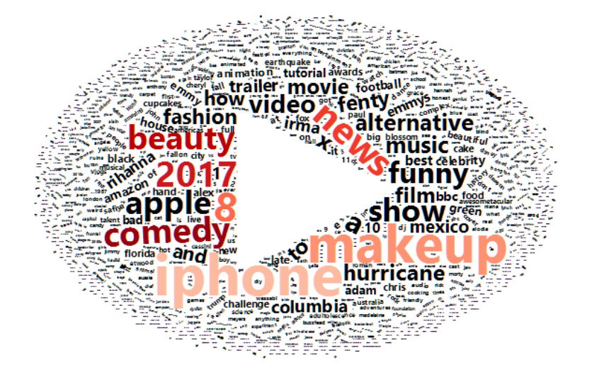

Analysis 1. 태그 분석
PT DESIGN
PURE
RED+
WHITE
BASIC POWERPOINT PT DESIGN
CONTENTS
Start by doing what's necessary; then do what's possible; and suddenly you are doing the impossible.
- Francis of Assisi

Slide 6
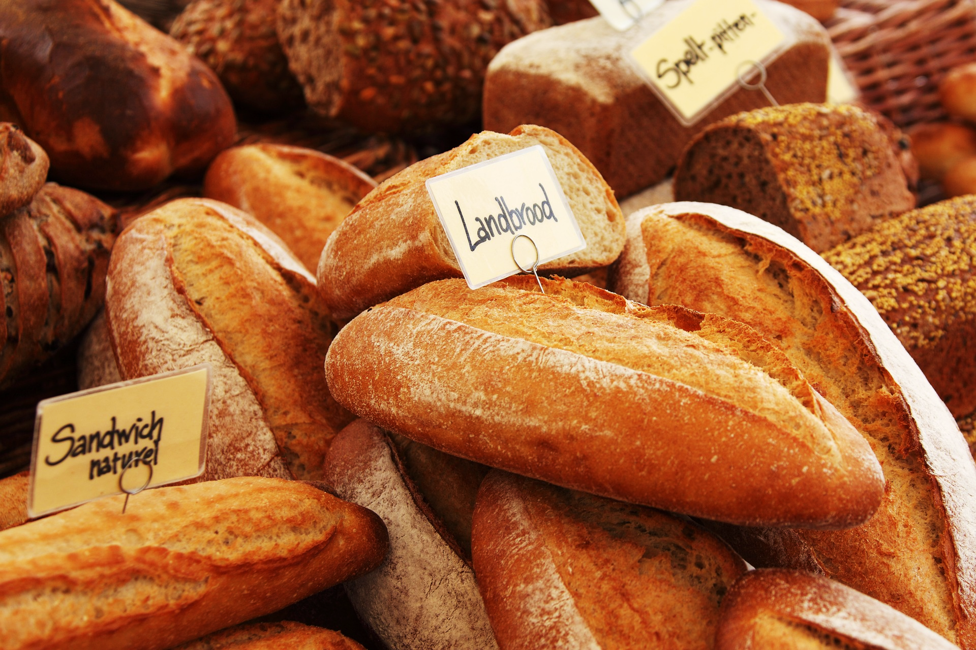
DESIGNED BY ADSTOREPOST.COM
우리의
안전지대
OUR
SAFETY
ZONE
BASIC POWERPOINT PT DESIGN
CONTENTS
The best preparation
for tomorrow is
doing your best today.
- H. Jackson Brown, Jr.
ADSTOREPOST

Slide 7
CON TEN TS.
DSEIGNED
B.Y
ADSTORE

